Slide 1

LinkedIn Administration
Sprint 4

Slide 2


Byte me Dirty Bits!
Team 6
Project Manager: Kevin
Scrum Master: Julian
Programmer 1: Jon
Programmer 2: Vishek
Tester: Gloria

Slide 3

Our Product
LinkedIn Application
Allows GSU faculty to search for GSU alumni on LinkedIn
Generates CSV file with search results
Value of the Administration Module
Handles the user login and registration components of the LinkedIn application
Polling functionality
Converts XML file to CSV
Notes:
Our product the linkedIn Application helps GSU faculty to search for GSU alumni on LinkedIn based on their Name, Position, Location, and the industry they work in.
The end result is a CSV file with query results.
In terms of the Admin Module, it verifies user registration and login aspects of the application.
It also adds polling functionality to the polling screen
It converts the XML file from the backend which has the search results to CSV

Slide 4
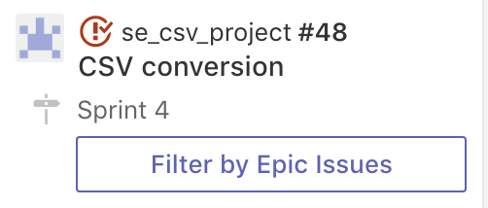
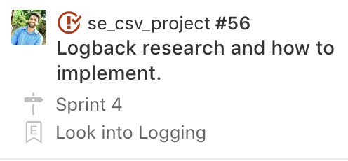
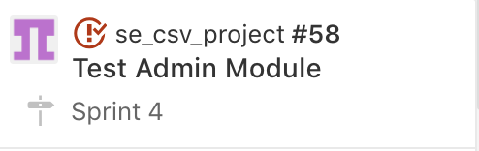
Completed Stories
Notes:
CSV Conversion
We were able to create a method that convert the xml file created by the backend to csv.
We also integrated the method with Java RMI so the client can invoke the method.
We also tested it to make sure an xml file could be converted
Logback
We also implemented some logging into the admin module
Everyime the rmi server runs, logs are generated so we can keep a record of an errors that may happen during execution.
Tested login/registration component from the last sprint
Made sure the login page and registration page was functioning without errors
Made sure all aspects were working like the RMI connection b/w server and client as well as DB connections

Slide 5
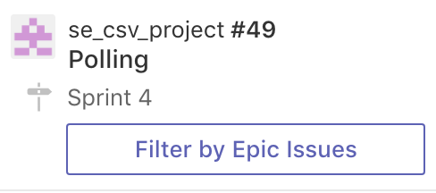
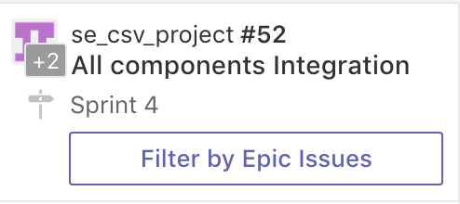
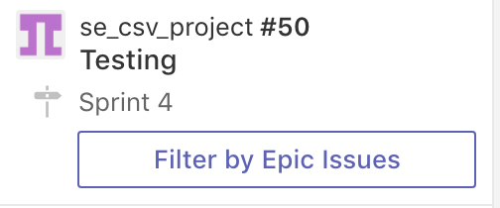
Backlog Stories
Notes:
In terms of Backlog
Polling

Slide 6
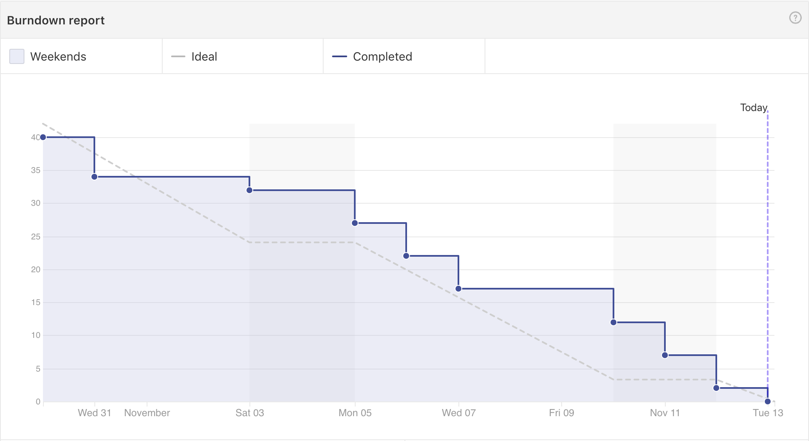
Burndown Chart

Slide 8
Test Scenario 1
Gloria was assigned to test the login and registration component of the admin module. After she starts the LinkedIn application, the frontend application will connect to the Admin module through Java RMI.
The admin module will connect to the RDS database and check if the username she registers is already in the database. If the username exists in the database, an error message will be displayed saying “username exists”
After she registers successfully, she will click login. If the username or password entered is incorrect, there will be an “incorrect username or password” error. Once she logs in successfully, the search window will show.
Notes:
For our first test scenario we are checking the login and registration component of the admin app. We are checking if the proper error message is shown if shown if the login credentials are incorrect or if the username that is being registered is already in the database. We are also checking that the RMI connections and database connections are made.

Slide 9
Scenario 1 Test Cases
Does the frontend establish RMI connection with the Admin module?
Does the admin module connect to the RDS database to check user credentials?
Does the “username exists” error message display when the user tries to register a username that is already in the database?
Does the “incorrect username or password” error message show when the user enters invalid credentials?
Does the search window show after the user logs in successfully?

Slide 10
Test Scenario 2
Jon was assigned to test the polling and csv parts of the admin module. After he creates a search request, the polling screen will show. While the polling screen is displayed, the front end will connect to the admin module via RMI.
The admin module will check the database for the query completed status. Once the query has completed, the xml file generated by the backend will be converted to csv. The polling screen will change to the results screen which will have the csv file.
Notes:
For our second test scenario we are checking if the polling and csv components are working. We are also checking to see if the database and RMI connections are made.

Slide 11
Scenario 2 Test Cases
Does the polling screen show up after search is clicked?
Does the front end connect to the admin via RMI ?
Does the admin module connect to the database to check the query completion status?
Does the xml file successfully convert to CSV?
Does the result page have the CSV file ?

Slide 12


Questions?
Thank You

